Slide 1
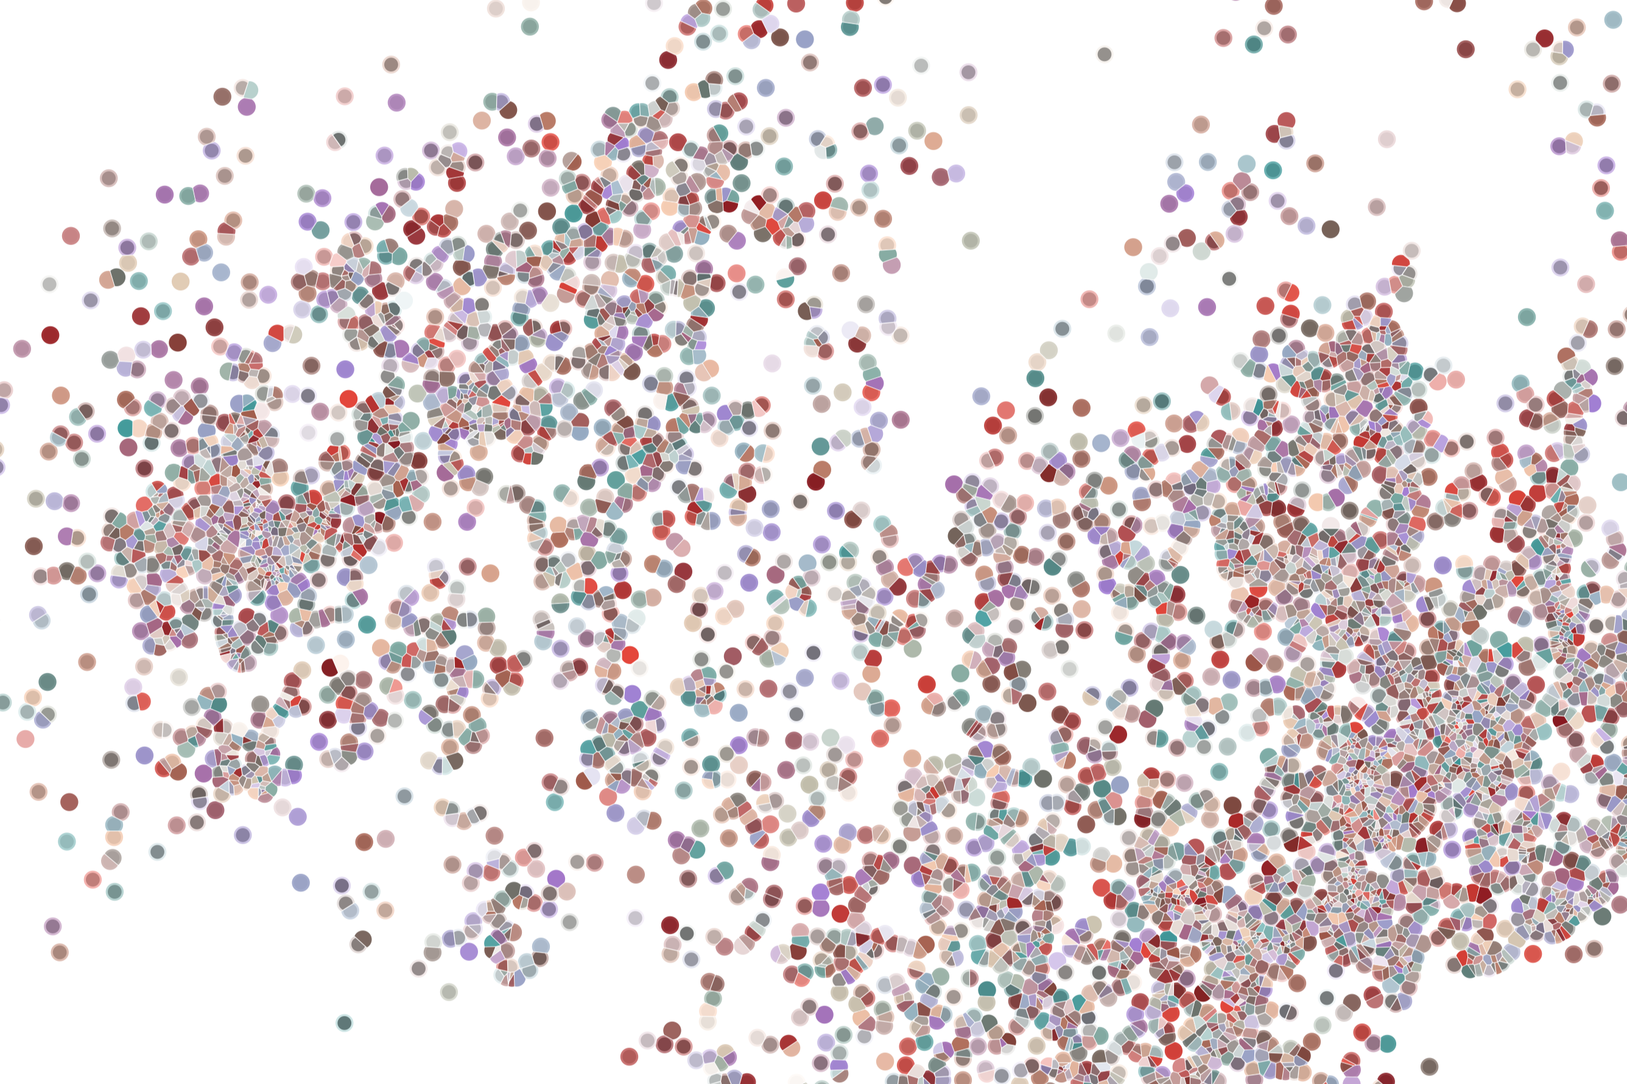
Lecture 5 Identifying cell populations
Physalia course 2021 — Single-cell RNA-seq with R/Bioconductor
Instructors: Jacques Serizay
Notes:
Hello everybody and thank you for attending my presentation. I am going to talk about the project I recently started working on in the Spassky and Koszul labs, both located in Paris. This project focuses on the unusual cooption of the mitotic machinery to drive, not cell division but cell differentiation.

Slide 2


Analysis workflow
Pre-Processing
Clustering
Biology
Expression Matrix
(GENES x CELLS)
1. Identify
Variable Genes
5. Differentially Expressed Genes
Filter Cells /
Quality Control
2. Dimensionality Reduction
6. Assigning
Cell Type
Normalization
3. Clustering
7. Functional Annotation
4. Explore (known)
marker genes
Notes:
I would like to expand these observations to in vivo data. I also want to check what happens in terms of transcriptional dynamics in cells where Cyclin O, a key non-canonical cyclin involved in MCC diff., is knocked-out.

Slide 3
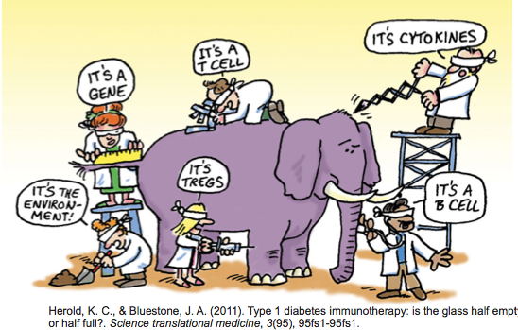
How Do We Define Cellular Identity?
A cell participates in multiple processes/contexts.
3
Notes:
I would like to expand these observations to in vivo data. I also want to check what happens in terms of transcriptional dynamics in cells where Cyclin O, a key non-canonical cyclin involved in MCC diff., is knocked-out.

Slide 4
Analysis workflow
Pre-Processing
Clustering
Biology
Expression Matrix
(GENES x CELLS)
1. Identify
Variable Genes
5. Differentially Expressed Genes
Filter Cells /
Quality Control
2. Dimensionality Reduction
6. Assigning
Cell Type
Normalization
3. Clustering
7. Functional Annotation
4. Explore (known)
marker genes
Notes:
I would like to expand these observations to in vivo data. I also want to check what happens in terms of transcriptional dynamics in cells where Cyclin O, a key non-canonical cyclin involved in MCC diff., is knocked-out.

Slide 5
Making sense of variation
For something to be informative, it needs to exhibit variation
5
Notes:
I would like to expand these observations to in vivo data. I also want to check what happens in terms of transcriptional dynamics in cells where Cyclin O, a key non-canonical cyclin involved in MCC diff., is knocked-out.

Slide 6

Making sense of variation
For something to be informative, it needs to exhibit variation
QUESTION: Can I group these emoticons by their facial hair style?
6
Notes:
I would like to expand these observations to in vivo data. I also want to check what happens in terms of transcriptional dynamics in cells where Cyclin O, a key non-canonical cyclin involved in MCC diff., is knocked-out.

Slide 7

Making sense of variation
Not everything that exhibits variation is informative. It depends on the question!
QUESTION: Which ones of these emoticons are smiling?
7
Notes:
I would like to expand these observations to in vivo data. I also want to check what happens in terms of transcriptional dynamics in cells where Cyclin O, a key non-canonical cyclin involved in MCC diff., is knocked-out.

Slide 8
Making sense of variation
Cells are in ~20,000 dimensional space (one dimension per gene)
Many genes are lowly detected or noisy measurements
Variable genes contain the biological signal we are interested in
8
Notes:
I would like to expand these observations to in vivo data. I also want to check what happens in terms of transcriptional dynamics in cells where Cyclin O, a key non-canonical cyclin involved in MCC diff., is knocked-out.

Slide 9
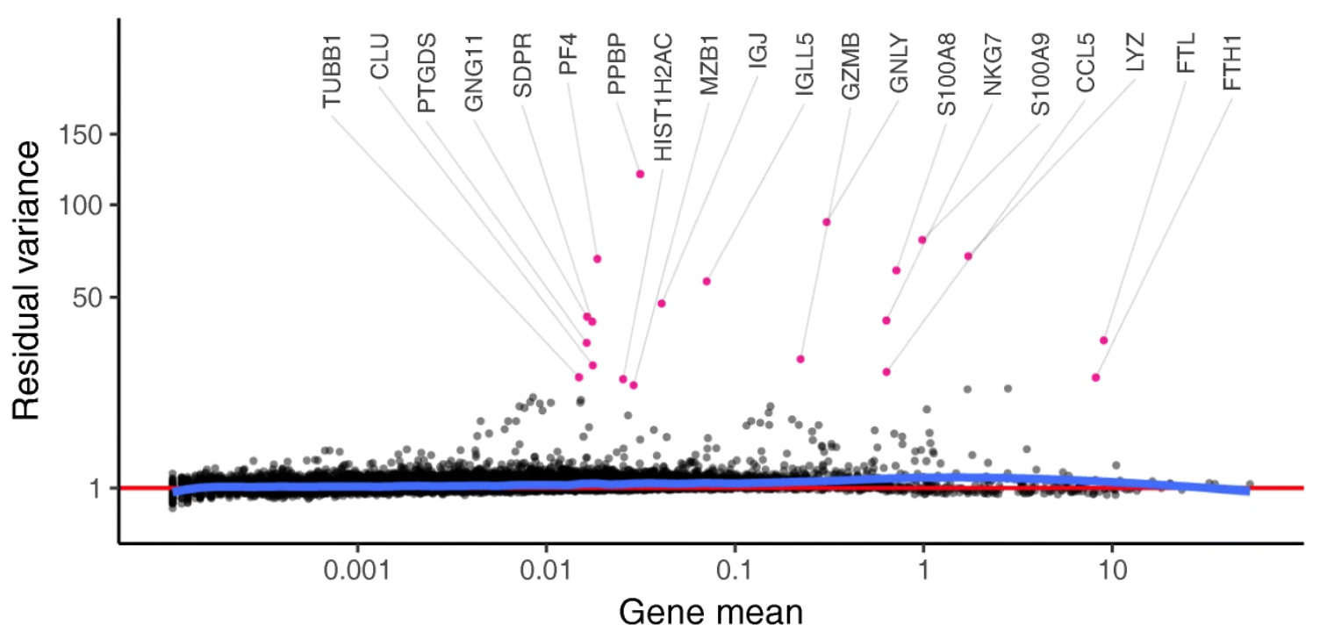
Making sense of variation
The most used approach is to find genes that have high residual variance
9
Notes:
I would like to expand these observations to in vivo data. I also want to check what happens in terms of transcriptional dynamics in cells where Cyclin O, a key non-canonical cyclin involved in MCC diff., is knocked-out.

Slide 10
Making sense of variation
The most used approach is to find genes that have high residual variance
Either taking the first n genes (ranked by decreasing residual variance)
e.g. 200-2000 genes
10
Notes:
I would like to expand these observations to in vivo data. I also want to check what happens in terms of transcriptional dynamics in cells where Cyclin O, a key non-canonical cyclin involved in MCC diff., is knocked-out.

Slide 11
Making sense of variation
The most used approach is to find genes that have high residual variance
Either taking the first n genes (ranked by decreasing residual variance)
e.g. 200-2000 genes
Or by taking the first % genes (ranked by decreasing residual variance)
e.g. 2-10% genes
11
Notes:
I would like to expand these observations to in vivo data. I also want to check what happens in terms of transcriptional dynamics in cells where Cyclin O, a key non-canonical cyclin involved in MCC diff., is knocked-out.

Slide 12
Making sense of variation
The most used approach is to find genes that have high residual variance
Either taking the first n genes (ranked by decreasing residual variance)
e.g. 200-2000 genes
Or by taking the first % genes (ranked by decreasing residual variance)
e.g. 2-10% genes
→ Or by taking all genes with a residual variance > threshold
e.g. genes with residual variance > 0.02
12
Notes:
I would like to expand these observations to in vivo data. I also want to check what happens in terms of transcriptional dynamics in cells where Cyclin O, a key non-canonical cyclin involved in MCC diff., is knocked-out.

Slide 13
Analysis workflow
Pre-Processing
Clustering
Biology
Expression Matrix
(GENES x CELLS)
1. Identify
Variable Genes
5. Differentially Expressed Genes
Filter Cells /
Quality Control
2. Dimensionality Reduction
6. Assigning
Cell Type
Normalization
3. Clustering
7. Functional Annotation
4. Explore (known)
marker genes
Notes:
I would like to expand these observations to in vivo data. I also want to check what happens in terms of transcriptional dynamics in cells where Cyclin O, a key non-canonical cyclin involved in MCC diff., is knocked-out.

Slide 14
Dimensional reduction in scRNAseq studies
High-dimensional data can be difficult to interpret.
One approach to simplification is to assume that the data of interest lies within lower-dimensional space. If the data of interest is of low enough dimension, the data can be visualised in the low-dimensional space.
A scRNA seq starts with many measurements (features, genes).
We want to reduce it to fewer informative dimensions.
We have starting doing this by using only highly variable genes.
We can further reduce dimension with linear or non-linear approaches.
14
Notes:
I would like to expand these observations to in vivo data. I also want to check what happens in terms of transcriptional dynamics in cells where Cyclin O, a key non-canonical cyclin involved in MCC diff., is knocked-out.

Slide 15
Dimensional reduction in scRNAseq studies
High-dimensional data can be difficult to interpret.
One approach to simplification is to assume that the data of interest lies within lower-dimensional space. If the data of interest is of low enough dimension, the data can be visualised in the low-dimensional space.
Common Techniques
Principal Component Analysis (PCA)
Independent Component Analysis (ICA)
Multidimensional Scaling (MDS)
Non-negative Matrix Factorization (NMF)
Probabilistic Modeling (e.g. Latent Dirichlet Allocation - LDA)
15
Notes:
I would like to expand these observations to in vivo data. I also want to check what happens in terms of transcriptional dynamics in cells where Cyclin O, a key non-canonical cyclin involved in MCC diff., is knocked-out.

Slide 16
Principal Component Analysis
PCA is a dimensionality reduction method that transforms a set of features into a set of linearly uncorrelated variables called principal components
1,000s cells
1,000s cells
10,000 genes
(few) Principal components
https://stats.stackexchange.com/questions/2691/making-sense-of-principal-component-analysis-eigenvectors-eigenvalues
16
Notes:
I would like to expand these observations to in vivo data. I also want to check what happens in terms of transcriptional dynamics in cells where Cyclin O, a key non-canonical cyclin involved in MCC diff., is knocked-out.

Slide 17

Principal Component Analysis
PCA is a dimensionality reduction method that transforms a set of features into a set of linearly uncorrelated variables called principal components
The first principal component contains the most variance, and each component after contains as much variance while still being orthogonal to other components
https://stats.stackexchange.com/questions/2691/making-sense-of-principal-component-analysis-eigenvectors-eigenvalues
17
Notes:
I would like to expand these observations to in vivo data. I also want to check what happens in terms of transcriptional dynamics in cells where Cyclin O, a key non-canonical cyclin involved in MCC diff., is knocked-out.

Slide 18
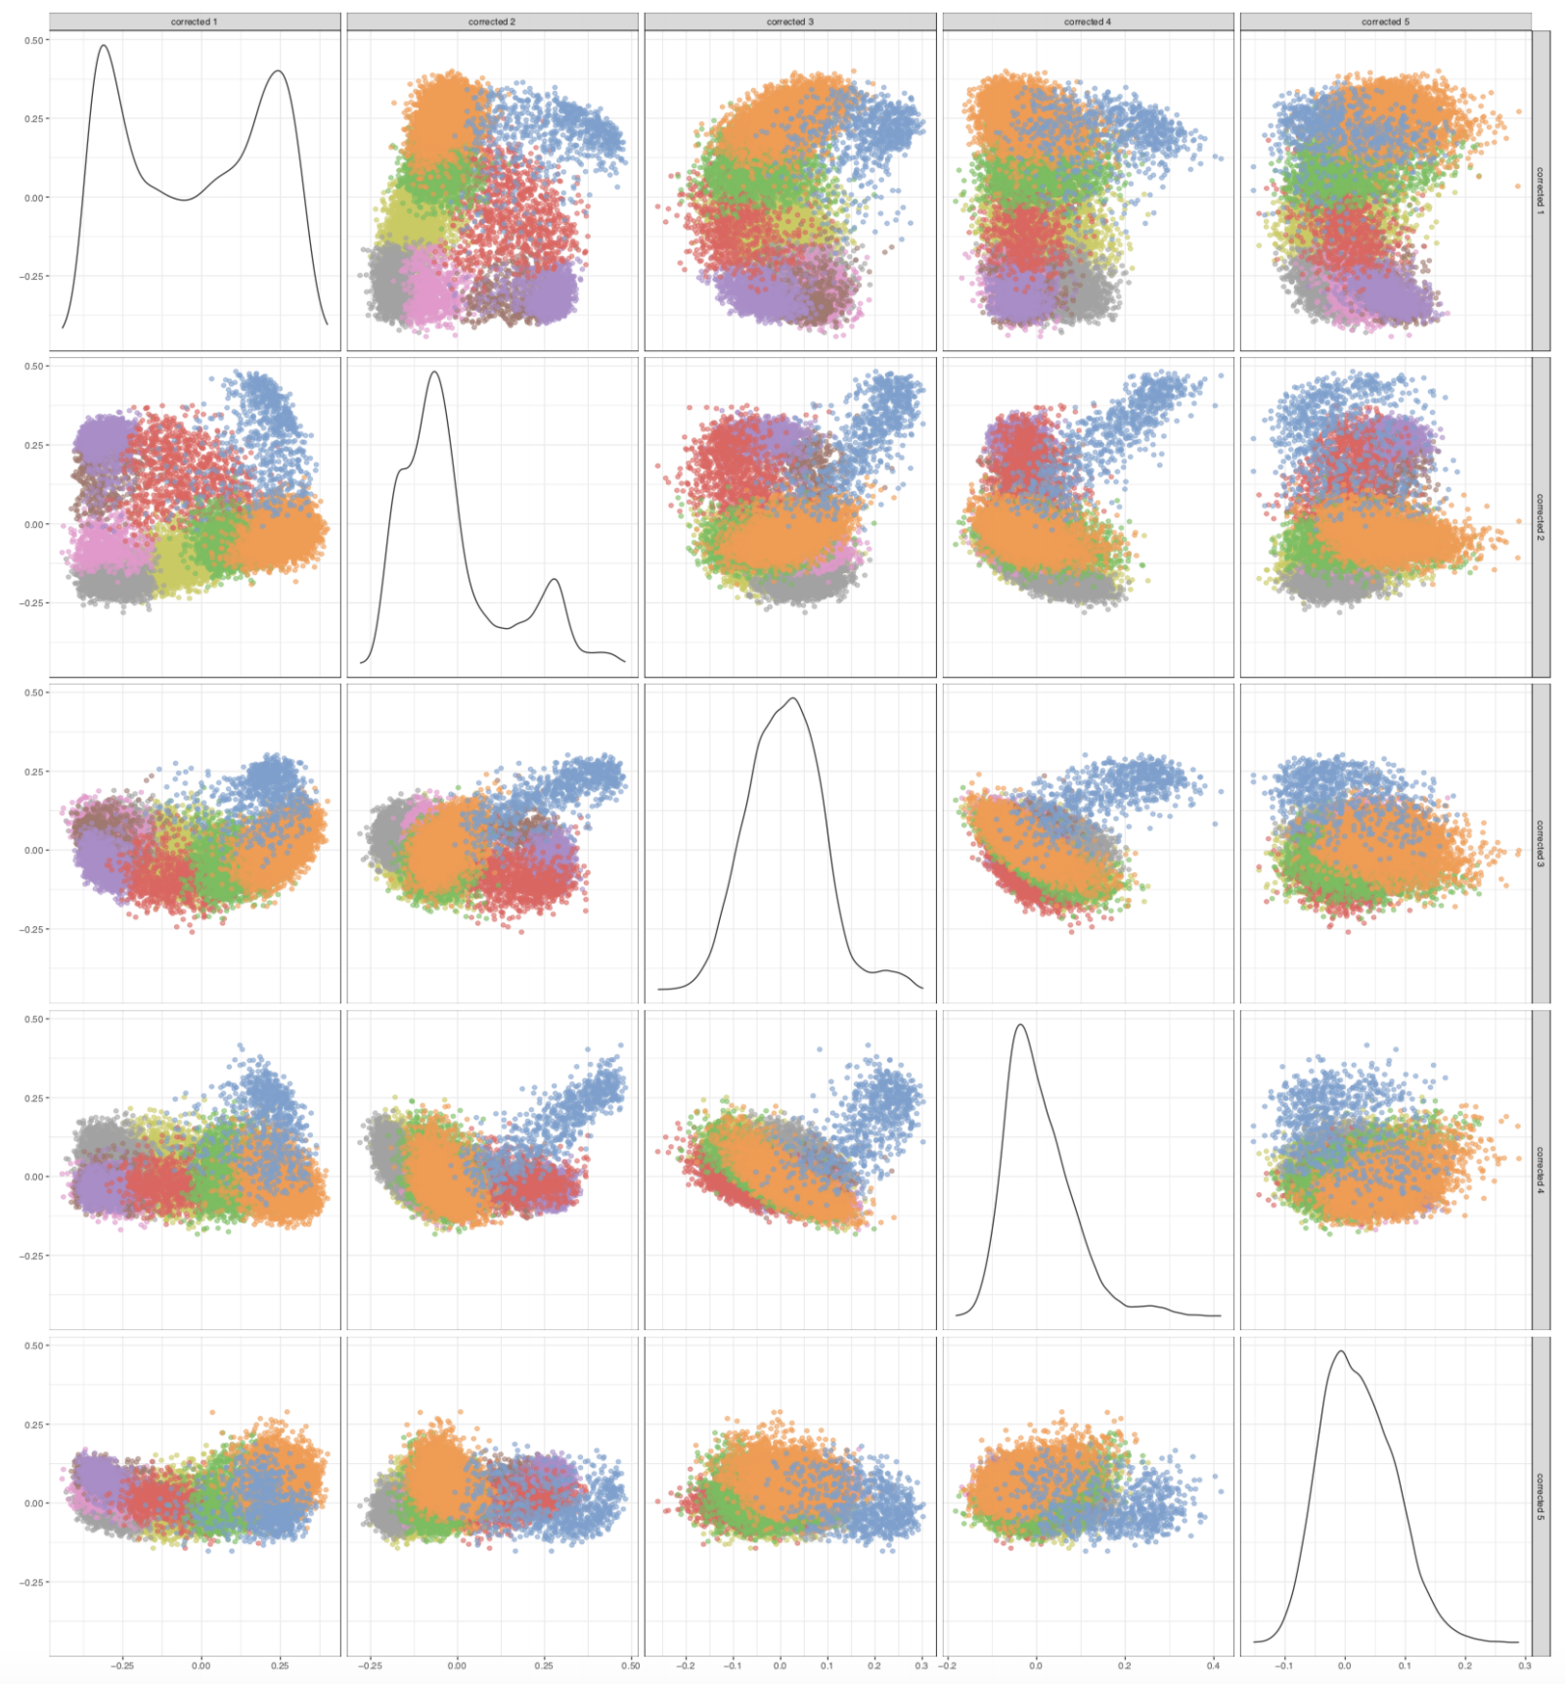
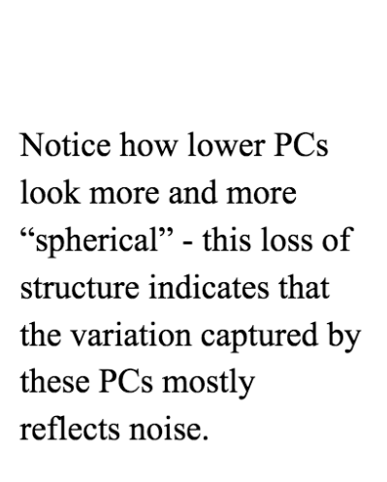
Principal Component Analysis: assessing lower dimensions
18
Notes:
I would like to expand these observations to in vivo data. I also want to check what happens in terms of transcriptional dynamics in cells where Cyclin O, a key non-canonical cyclin involved in MCC diff., is knocked-out.

Slide 19
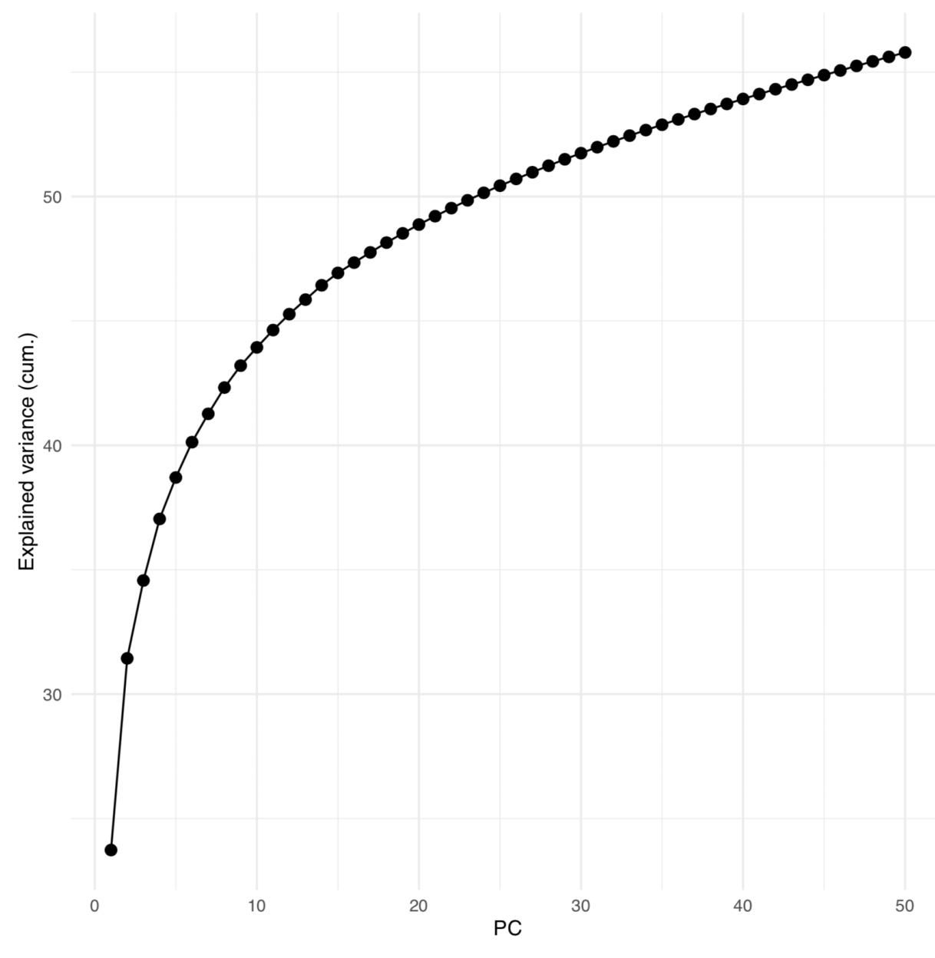
Principal Component Analysis: assessing lower dimensions
19
Notes:
I would like to expand these observations to in vivo data. I also want to check what happens in terms of transcriptional dynamics in cells where Cyclin O, a key non-canonical cyclin involved in MCC diff., is knocked-out.

Slide 20
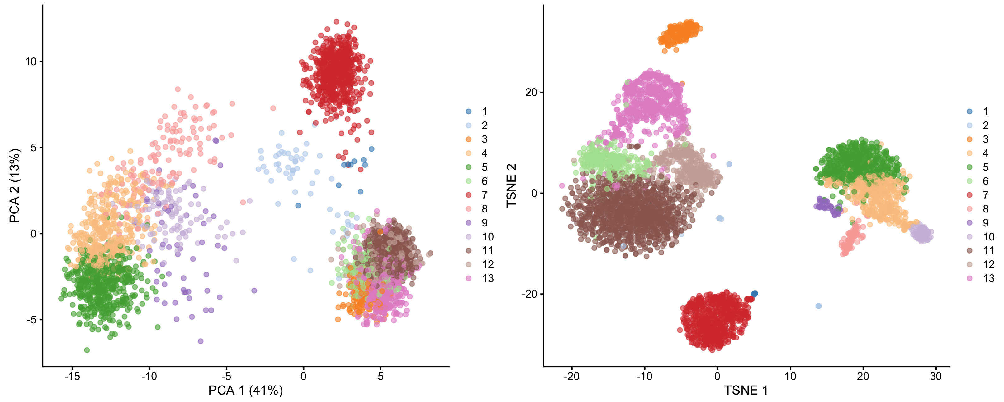
Going further: non-linear dimensional reductions
In a t-SNE projection, similar objects (cells) are modeled by nearby two-(three)dimensional points and dissimilar objects are modeled by distant points with high probability.
1,000s cells
1,000s cells
10,000 genes
(few) Principal components
20
Notes:
I would like to expand these observations to in vivo data. I also want to check what happens in terms of transcriptional dynamics in cells where Cyclin O, a key non-canonical cyclin involved in MCC diff., is knocked-out.

Slide 21
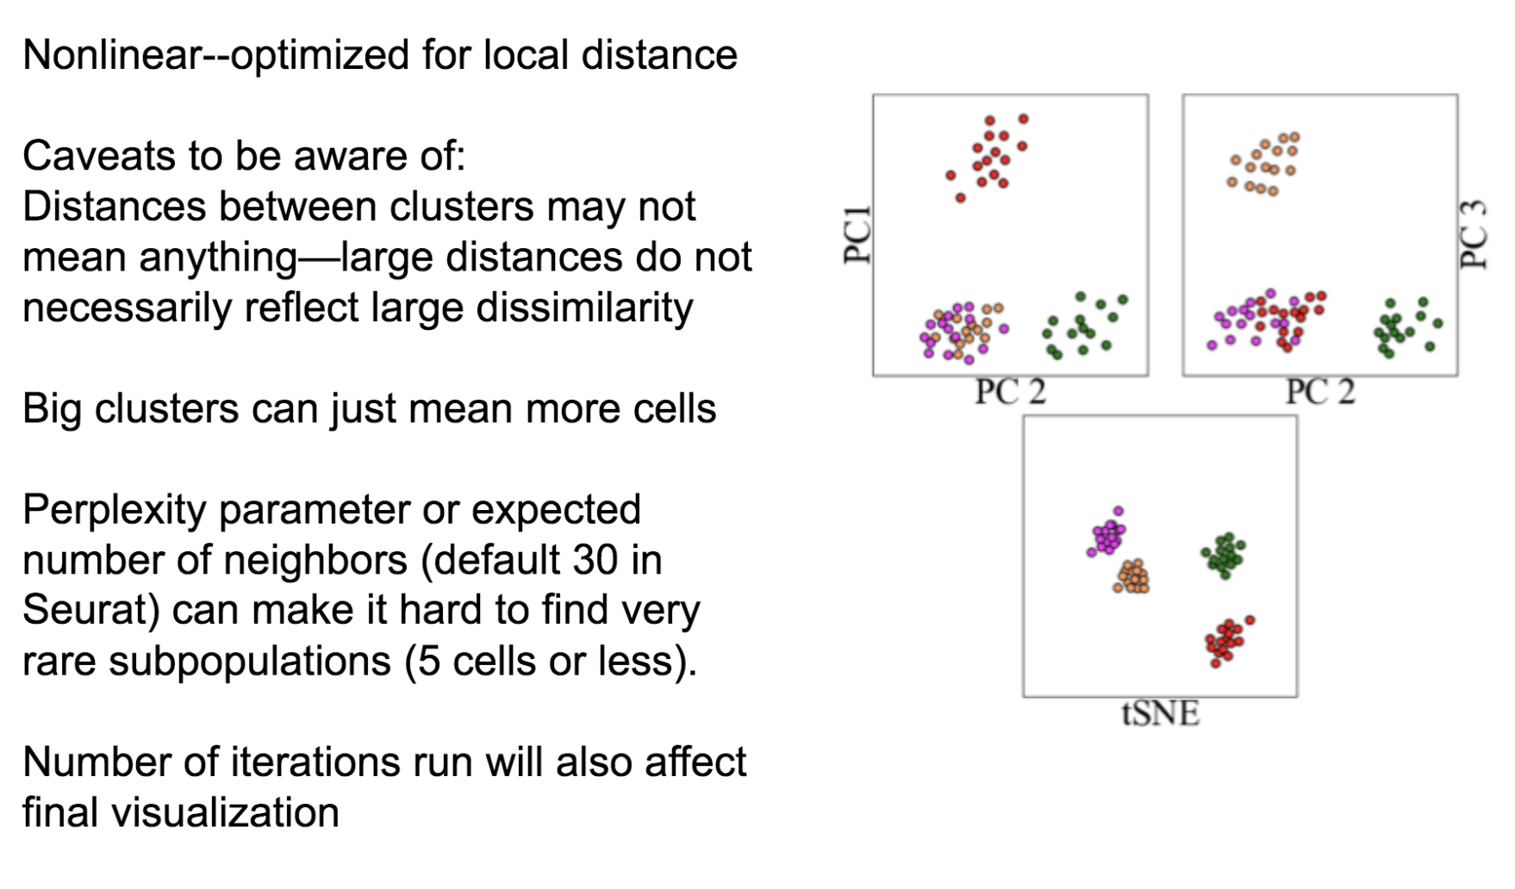
Caution with tSNE visualization
A great tSNE resource! https://distill.pub/2016/misread-tsne/
21
Notes:
I would like to expand these observations to in vivo data. I also want to check what happens in terms of transcriptional dynamics in cells where Cyclin O, a key non-canonical cyclin involved in MCC diff., is knocked-out.

Slide 22
Caution with tSNE visualization
A great tSNE resource! https://distill.pub/2016/misread-tsne/
22
Notes:
I would like to expand these observations to in vivo data. I also want to check what happens in terms of transcriptional dynamics in cells where Cyclin O, a key non-canonical cyclin involved in MCC diff., is knocked-out.

Slide 23
Other non-linear dimensional reduction approaches
Force-directed graph embedding
UMAP
Diffusion Maps
Non-negative Matrix Factorization
Probabilistic (topic models/Latent Dirichlet Allocation (LDA))
BE AWARE!!
Some are linear, some other are not.
While PCA is a general “one-size-fits-all” approach, others will yield more specific outputs, targeting a particular question.
23
Notes:
I would like to expand these observations to in vivo data. I also want to check what happens in terms of transcriptional dynamics in cells where Cyclin O, a key non-canonical cyclin involved in MCC diff., is knocked-out.

Slide 24
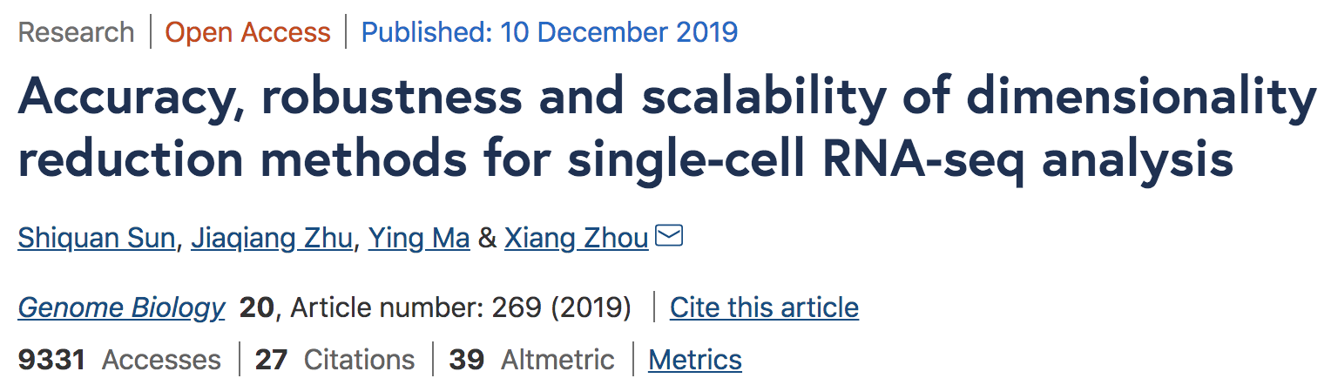
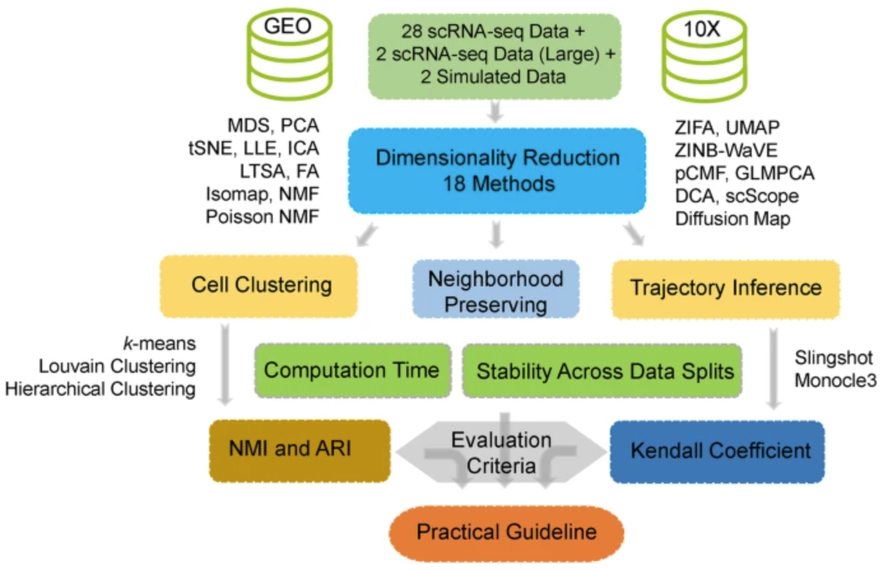
Other non-linear dimensional reduction approaches
24
Notes:
I would like to expand these observations to in vivo data. I also want to check what happens in terms of transcriptional dynamics in cells where Cyclin O, a key non-canonical cyclin involved in MCC diff., is knocked-out.

Slide 25
Analysis workflow
Pre-Processing
Clustering
Biology
Expression Matrix
(GENES x CELLS)
1. Identify
Variable Genes
5. Differentially Expressed Genes
Filter Cells /
Quality Control
2. Dimensionality Reduction
6. Assigning
Cell Type
Normalization
3. Clustering
7. Functional Annotation
4. Explore (known)
marker genes
Notes:
I would like to expand these observations to in vivo data. I also want to check what happens in terms of transcriptional dynamics in cells where Cyclin O, a key non-canonical cyclin involved in MCC diff., is knocked-out.

Slide 26
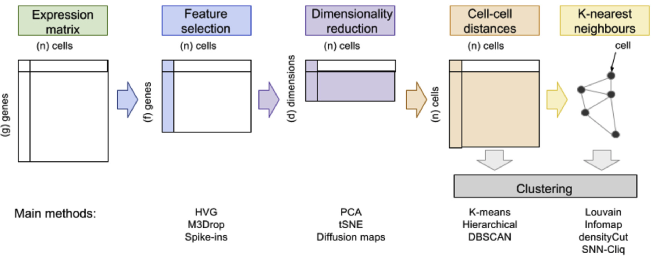
Different methodologies for clustering
Andrews et al., 2018
26
Notes:
I would like to expand these observations to in vivo data. I also want to check what happens in terms of transcriptional dynamics in cells where Cyclin O, a key non-canonical cyclin involved in MCC diff., is knocked-out.

Slide 27
”Traditional” clustering
Andrews et al., 2018
27
Notes:
I would like to expand these observations to in vivo data. I also want to check what happens in terms of transcriptional dynamics in cells where Cyclin O, a key non-canonical cyclin involved in MCC diff., is knocked-out.

Slide 28
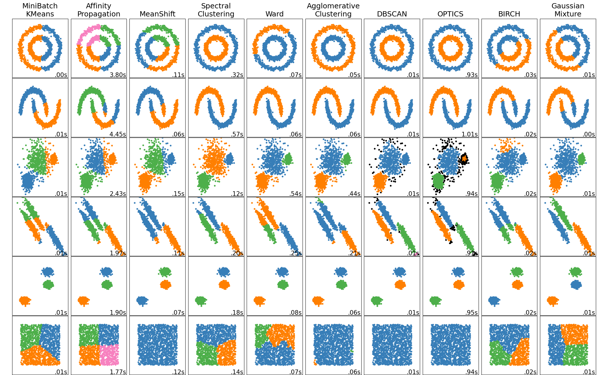
”Traditional” clustering
https://scikit-learn.org/stable/modules/clustering.html#overview-of-clustering-methods
28
Notes:
I would like to expand these observations to in vivo data. I also want to check what happens in terms of transcriptional dynamics in cells where Cyclin O, a key non-canonical cyclin involved in MCC diff., is knocked-out.

Slide 29
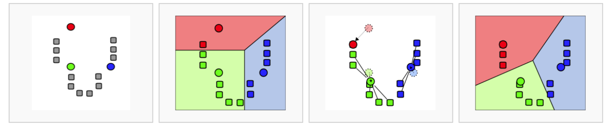
”Traditional” clustering
K-means algorithm is both fast and generally reliable, as a first approach.
29
Notes:
I would like to expand these observations to in vivo data. I also want to check what happens in terms of transcriptional dynamics in cells where Cyclin O, a key non-canonical cyclin involved in MCC diff., is knocked-out.

Slide 30
Why do we need graph-based clustering?
Curse of dimensionality:
“All data become sparse in high-dimensional space and therefore similarities measured by Euclidean distances etc are generally low between all objects.”
There is no point performing a hierarchical clustering of 10,000 cells if 90% of the pairwise distances are null !!
Andrews et al., 2018
30
Notes:
I would like to expand these observations to in vivo data. I also want to check what happens in terms of transcriptional dynamics in cells where Cyclin O, a key non-canonical cyclin involved in MCC diff., is knocked-out.

Slide 31
Graph-based clustering
Andrews et al., 2018
31
Notes:
I would like to expand these observations to in vivo data. I also want to check what happens in terms of transcriptional dynamics in cells where Cyclin O, a key non-canonical cyclin involved in MCC diff., is knocked-out.

Slide 32
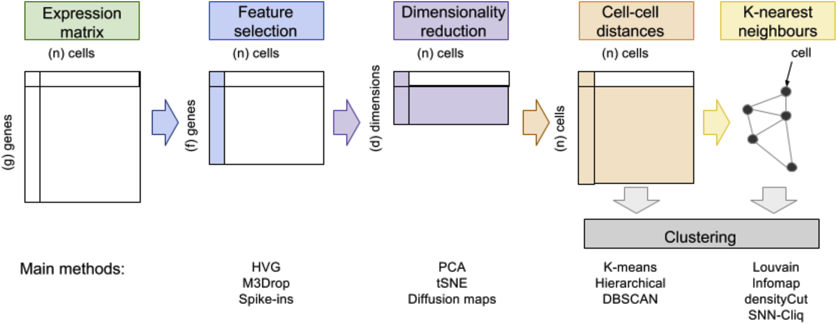

Building a k-Nearest Neighbors graph (with k = 4)
32
Notes:
I would like to expand these observations to in vivo data. I also want to check what happens in terms of transcriptional dynamics in cells where Cyclin O, a key non-canonical cyclin involved in MCC diff., is knocked-out.

Slide 33
Building a k-Nearest Neighbors graph (with k = 4)
1
33
Notes:
I would like to expand these observations to in vivo data. I also want to check what happens in terms of transcriptional dynamics in cells where Cyclin O, a key non-canonical cyclin involved in MCC diff., is knocked-out.

Slide 34
Building a k-Nearest Neighbors graph (with k = 4)
1
2
34
Notes:
I would like to expand these observations to in vivo data. I also want to check what happens in terms of transcriptional dynamics in cells where Cyclin O, a key non-canonical cyclin involved in MCC diff., is knocked-out.

Slide 35
Building a k-Nearest Neighbors graph (with k = 4)
1
3
2
35
Notes:
I would like to expand these observations to in vivo data. I also want to check what happens in terms of transcriptional dynamics in cells where Cyclin O, a key non-canonical cyclin involved in MCC diff., is knocked-out.

Slide 36
Building a k-Nearest Neighbors graph (with k = 4)
4
1
3
2
36
Notes:
I would like to expand these observations to in vivo data. I also want to check what happens in terms of transcriptional dynamics in cells where Cyclin O, a key non-canonical cyclin involved in MCC diff., is knocked-out.

Slide 37
Building a k-Nearest Neighbors graph (with k = 4)
4
1
3
2
4
1
3
2
37
Notes:
I would like to expand these observations to in vivo data. I also want to check what happens in terms of transcriptional dynamics in cells where Cyclin O, a key non-canonical cyclin involved in MCC diff., is knocked-out.

Slide 38
Building a k-Nearest Neighbors graph (with k = 4)
38
Notes:
I would like to expand these observations to in vivo data. I also want to check what happens in terms of transcriptional dynamics in cells where Cyclin O, a key non-canonical cyclin involved in MCC diff., is knocked-out.

Slide 39
Extending KNN to SNN graphs (Shared Nearest Neighbors) (still with k = 4)
39
Notes:
I would like to expand these observations to in vivo data. I also want to check what happens in terms of transcriptional dynamics in cells where Cyclin O, a key non-canonical cyclin involved in MCC diff., is knocked-out.

Slide 40
Extending KNN to SNN graphs (Shared Nearest Neighbors) (still with k = 4)
Two cells are connected by an edge if any of their nearest neighbors are shared.
40
Notes:
I would like to expand these observations to in vivo data. I also want to check what happens in terms of transcriptional dynamics in cells where Cyclin O, a key non-canonical cyclin involved in MCC diff., is knocked-out.

Slide 41
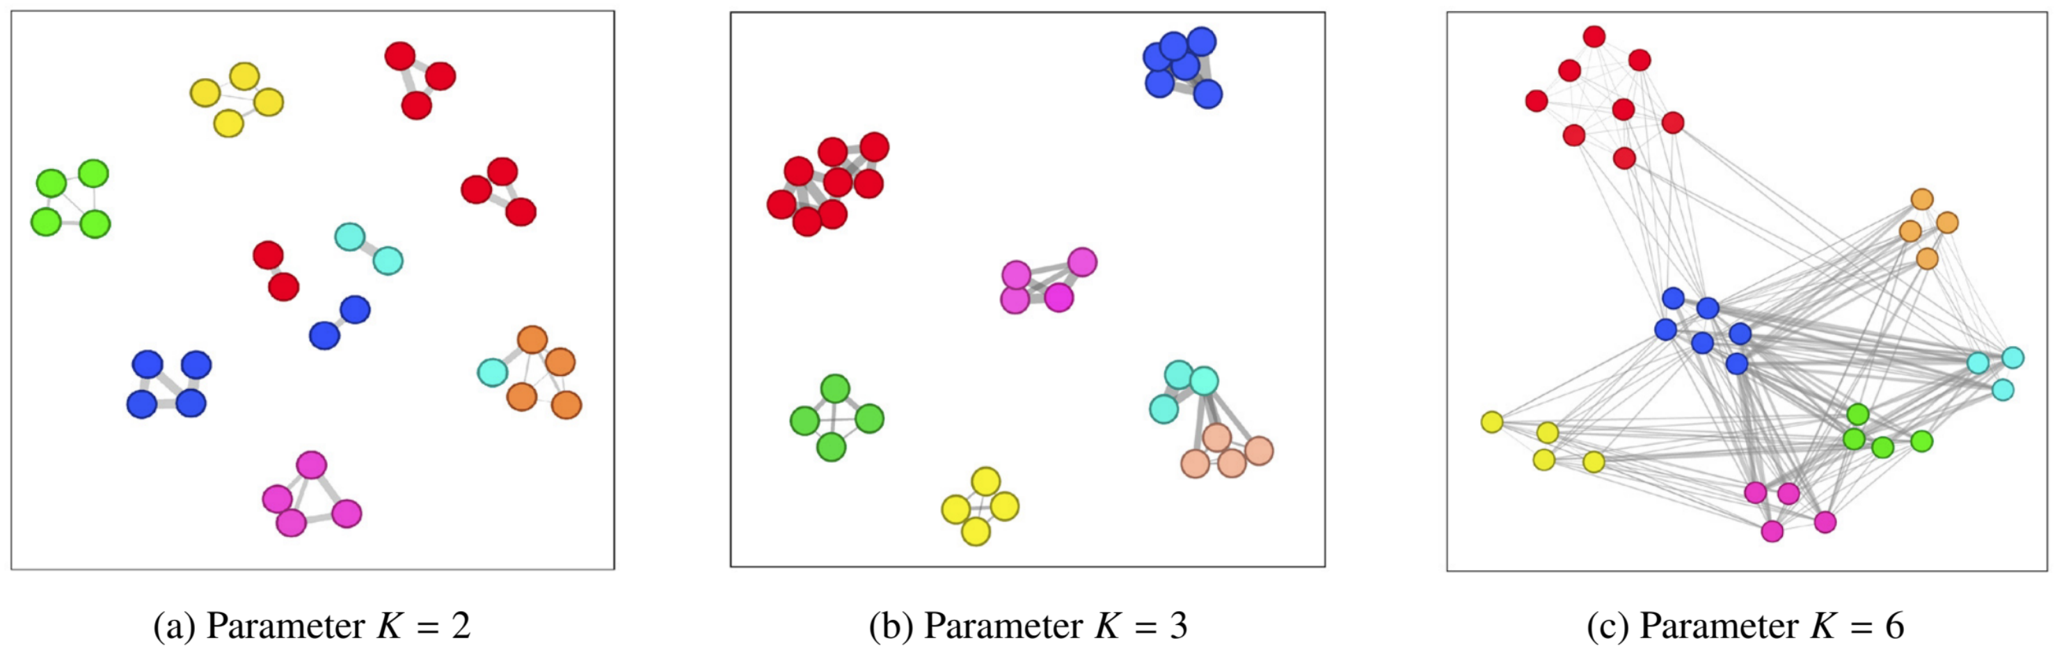
Extending KNN to SNN graphs (Shared Nearest Neighbors) (still with k = 4)
K is important when building KNN or SNN graphs !
41
Notes:
I would like to expand these observations to in vivo data. I also want to check what happens in terms of transcriptional dynamics in cells where Cyclin O, a key non-canonical cyclin involved in MCC diff., is knocked-out.

Slide 42
Graph-based clustering
Graph-based clustering is nothing more than community detection (an “old” field from ’00s).
42
Notes:
I would like to expand these observations to in vivo data. I also want to check what happens in terms of transcriptional dynamics in cells where Cyclin O, a key non-canonical cyclin involved in MCC diff., is knocked-out.

Slide 43
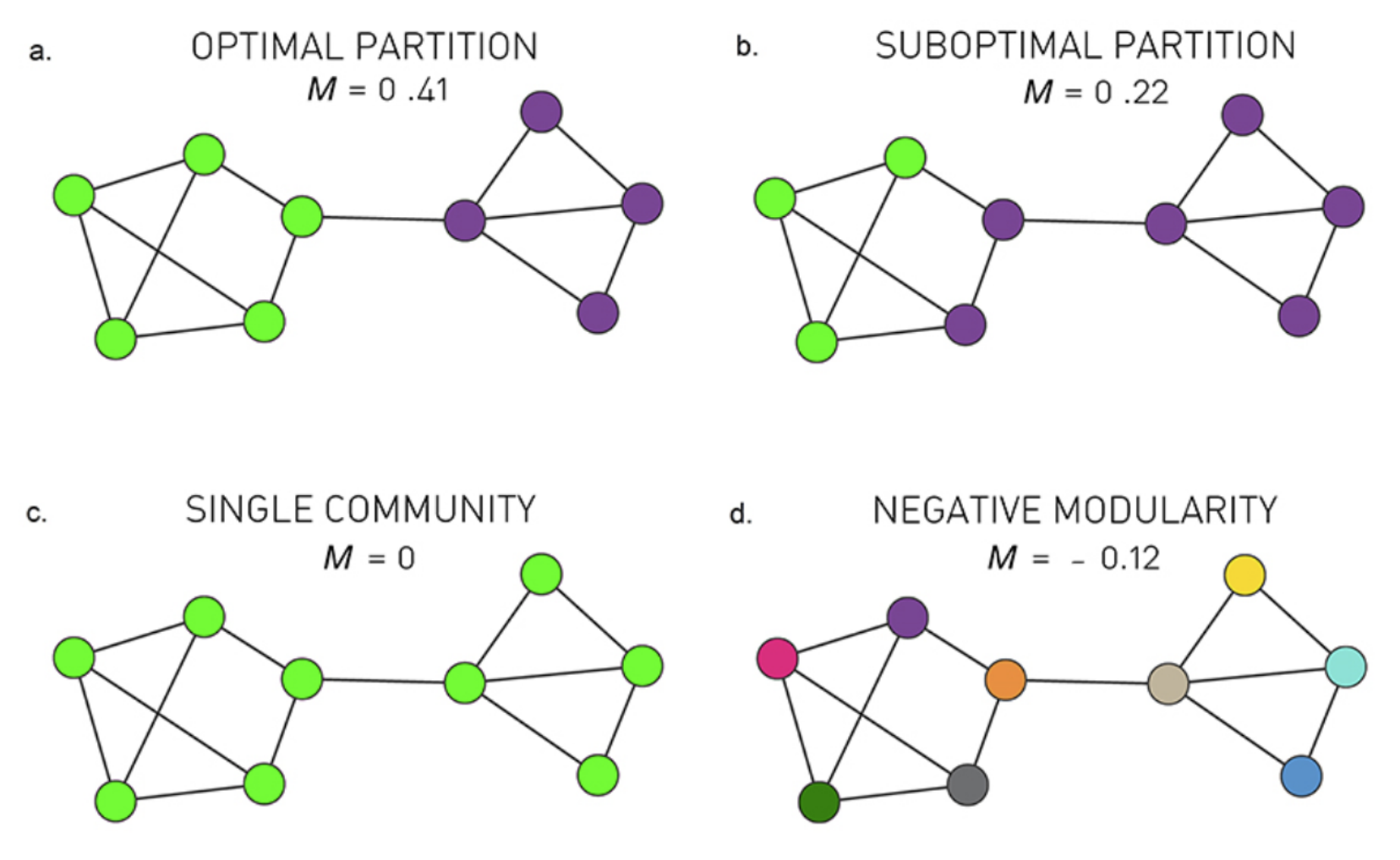
Graph-based clustering
Graph-based clustering is nothing more than community detection (an “old” field from ’00s).
Many different algorithms for community detection:
Louvain (heuristic)
Infomap
Walktrap
…
Most of them are based on modularity maximization
43
Notes:
I would like to expand these observations to in vivo data. I also want to check what happens in terms of transcriptional dynamics in cells where Cyclin O, a key non-canonical cyclin involved in MCC diff., is knocked-out.

Slide 44

Graph-based clustering
Graph-based clustering is nothing more than community detection (an “old” field from ’00s).
The Atlas for the Aspiring Network Scientist,
Michele Coscia 2021
44
Notes:
I would like to expand these observations to in vivo data. I also want to check what happens in terms of transcriptional dynamics in cells where Cyclin O, a key non-canonical cyclin involved in MCC diff., is knocked-out.

Slide 45
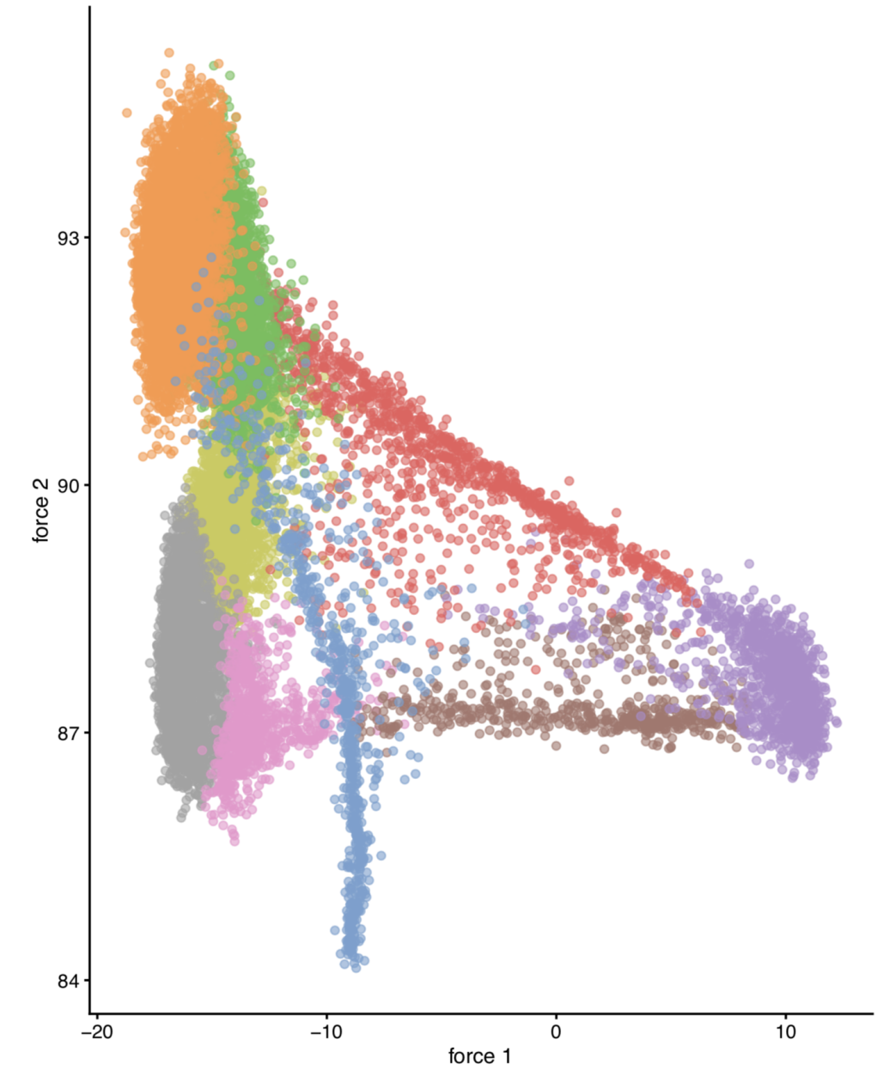
Graph-based clustering
CAREFUL!
A graph can be visualized (i.e. embedded) in 2D, but the graph-based clustering step (i.e. community finding) is not done on its 2D embedding!!
“Do not let the tail (of visualization) wag the dog (of quantitative analysis)”
-- A. Lun
45
Notes:
I would like to expand these observations to in vivo data. I also want to check what happens in terms of transcriptional dynamics in cells where Cyclin O, a key non-canonical cyclin involved in MCC diff., is knocked-out.

Slide 46
Analysis workflow
Pre-Processing
Clustering
Biology
Expression Matrix
(GENES x CELLS)
1. Identify
Variable Genes
5. Differentially Expressed Genes
Filter Cells /
Quality Control
2. Dimensionality Reduction
6. Assigning
Cell Type
Normalization
3. Clustering
7. Functional Annotation
4. Explore (known)
marker genes
Notes:
I would like to expand these observations to in vivo data. I also want to check what happens in terms of transcriptional dynamics in cells where Cyclin O, a key non-canonical cyclin involved in MCC diff., is knocked-out.

Slide 47
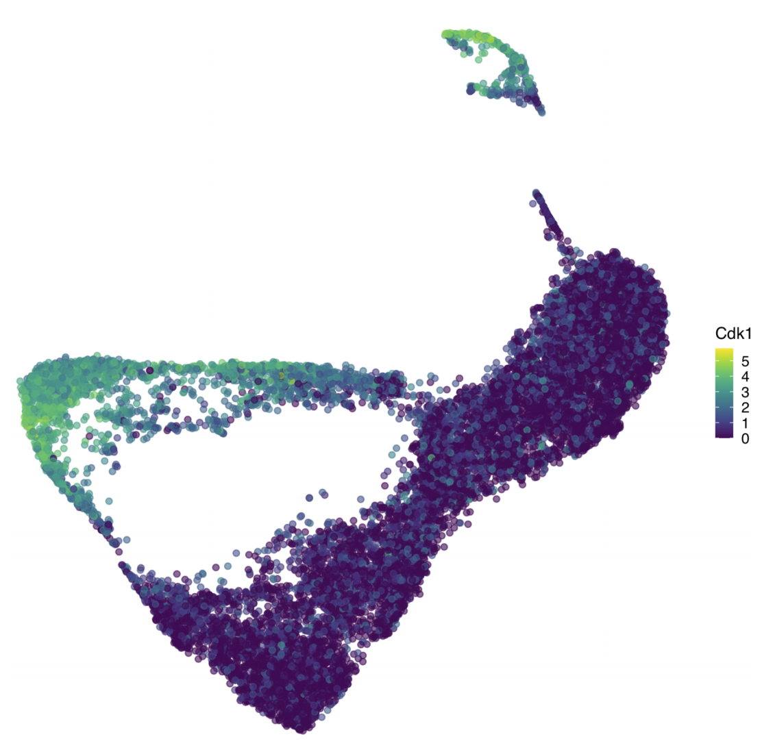
Visualizing expression of a gene of interest
On the dataset embedding:
47
Notes:
I would like to expand these observations to in vivo data. I also want to check what happens in terms of transcriptional dynamics in cells where Cyclin O, a key non-canonical cyclin involved in MCC diff., is knocked-out.

Slide 48
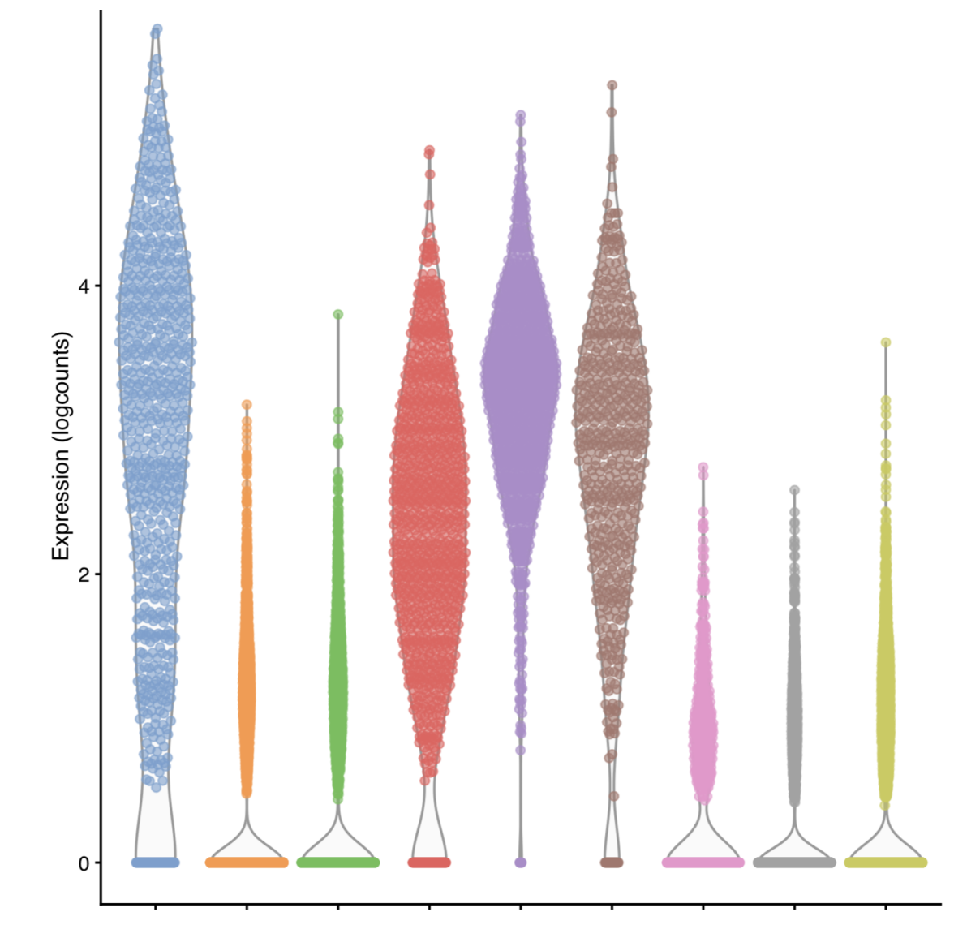
Visualizing expression of a gene of interest
On the dataset embedding:
By clusters:
48
Notes:
I would like to expand these observations to in vivo data. I also want to check what happens in terms of transcriptional dynamics in cells where Cyclin O, a key non-canonical cyclin involved in MCC diff., is knocked-out.

Slide 49
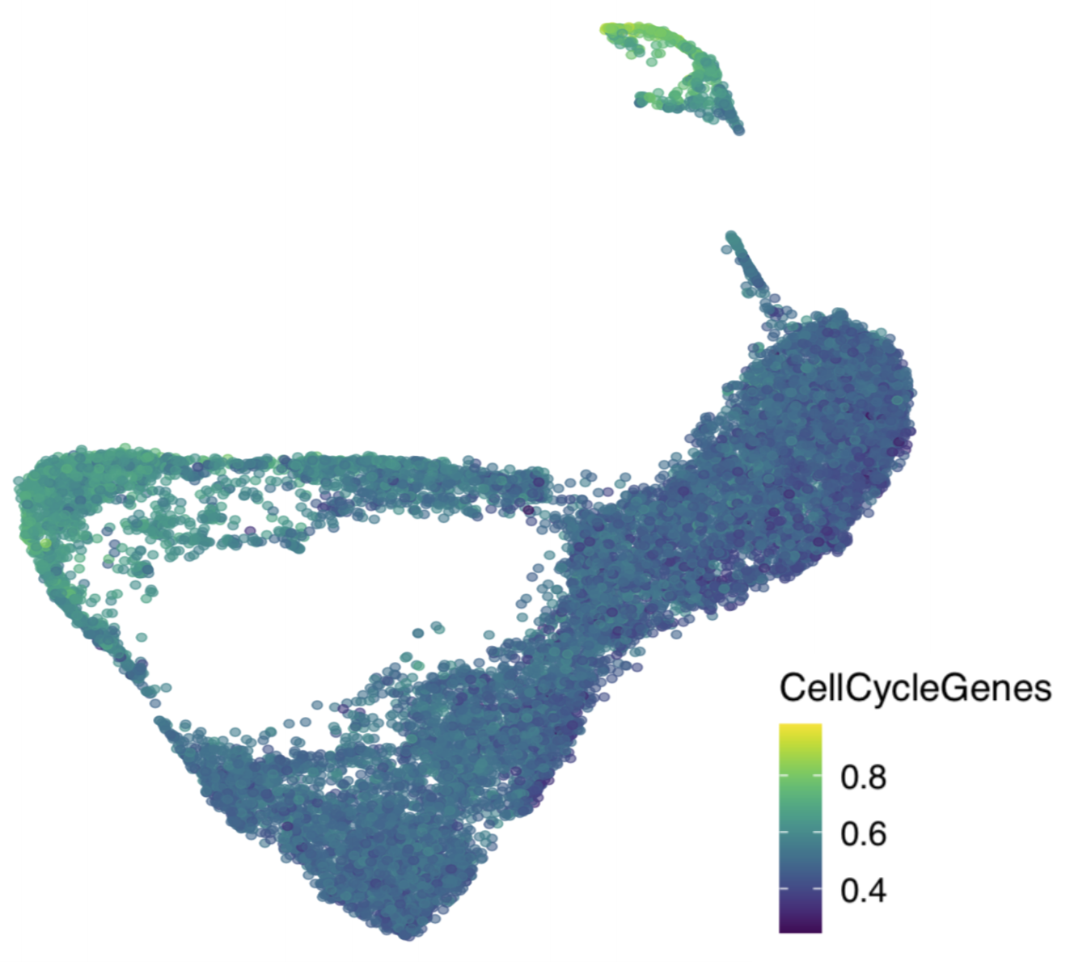
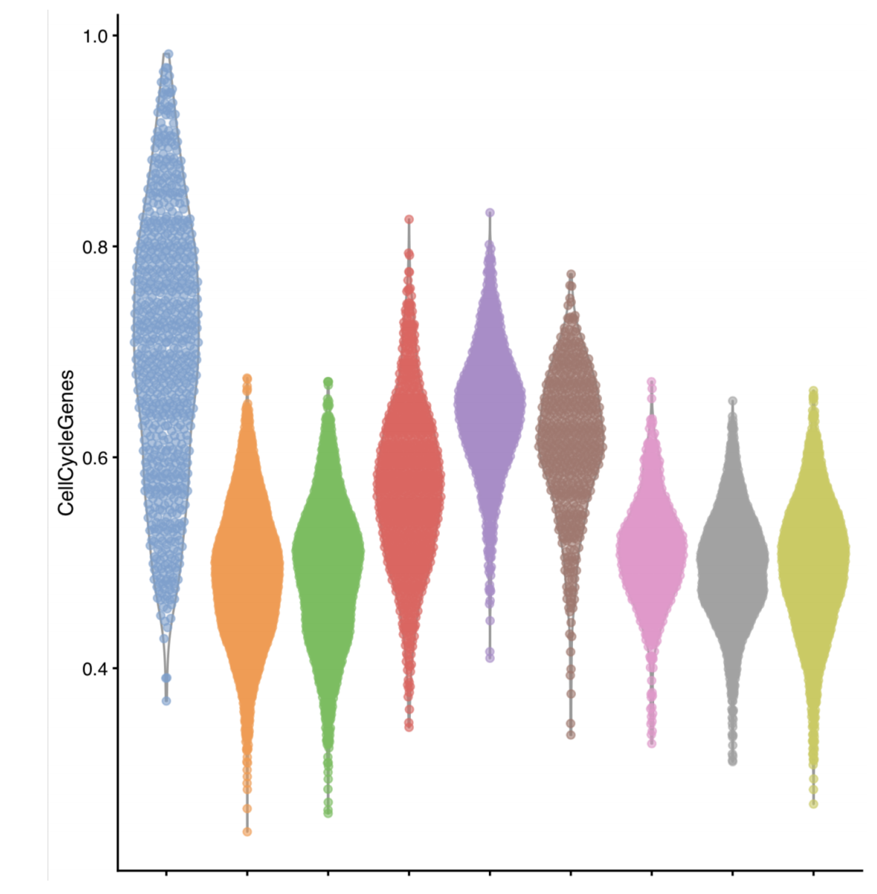
Visualizing expression of a module of interest
On the dataset embedding:
By clusters:
49
Notes:
I would like to expand these observations to in vivo data. I also want to check what happens in terms of transcriptional dynamics in cells where Cyclin O, a key non-canonical cyclin involved in MCC diff., is knocked-out.

Slide 50
Analysis workflow
Pre-Processing
Clustering
Biology
Expression Matrix
(GENES x CELLS)
1. Identify
Variable Genes
5. Differentially Expressed Genes
Filter Cells /
Quality Control
2. Dimensionality Reduction
6. Assigning
Cell Type
Normalization
3. Clustering
7. Functional Annotation
4. Explore (known)
marker genes
Notes:
I would like to expand these observations to in vivo data. I also want to check what happens in terms of transcriptional dynamics in cells where Cyclin O, a key non-canonical cyclin involved in MCC diff., is knocked-out.

Slide 51
Differential Expression Testing
In scRNA-seq we often do not have a defined set of experimental conditions.
Instead, we can perform pairwise comparisons of gene expression, between pairs of cell clusters, using some of the following tests:
"wilcox" : Wilcoxon rank sum test (default)
t" : Student’s t-test
"poisson" : Likelihood ratio test assuming an underlying poisson distribution. Use only for UMI-based datasets
"negbinom" : Likelihood ratio test assuming an underlying negative binomial distribution. Use only for UMI-based datasets
Others…
51
Notes:
I would like to expand these observations to in vivo data. I also want to check what happens in terms of transcriptional dynamics in cells where Cyclin O, a key non-canonical cyclin involved in MCC diff., is knocked-out.

Slide 52
Differential Expression Testing
In scRNA-seq we often do not have a defined set of experimental conditions.
Instead, we can perform pairwise comparisons of gene expression, between pairs of cell clusters, using some of the following tests:
See scran::findMarkers() for more info…
markers <- scran::findMarkers(
sce,
groups = sce$cluster,
test.type = ”t”
)
52
Notes:
I would like to expand these observations to in vivo data. I also want to check what happens in terms of transcriptional dynamics in cells where Cyclin O, a key non-canonical cyclin involved in MCC diff., is knocked-out.

Slide 53

Differential Expression Testing
Think about your experimental design!!!
BACKGROUND
N genes
N reads
BATCH
RUN
1,000s cells
53
Notes:
I would like to expand these observations to in vivo data. I also want to check what happens in terms of transcriptional dynamics in cells where Cyclin O, a key non-canonical cyclin involved in MCC diff., is knocked-out.

Slide 54
Differential Expression Testing
Think about your experimental design!!!
BACKGROUND
N genes
N reads
BATCH
RUN
1,000s cells
Not all the cells are the same: there are confounding variables.
54
Notes:
I would like to expand these observations to in vivo data. I also want to check what happens in terms of transcriptional dynamics in cells where Cyclin O, a key non-canonical cyclin involved in MCC diff., is knocked-out.

Slide 55
Differential Expression Testing
Think about your experimental design!!!
BACKGROUND
N genes
N reads
BATCH
RUN
1,000s cells
BLOCKING MATRIX
Not all the cells are the same: there are confounding variables.
markers <- scran::findMarkers(
sce,
groups = sce$cluster,
test.type = ”t”,
block = <BLOCKING MATRIX>
)
55
Notes:
I would like to expand these observations to in vivo data. I also want to check what happens in terms of transcriptional dynamics in cells where Cyclin O, a key non-canonical cyclin involved in MCC diff., is knocked-out.

Slide 56
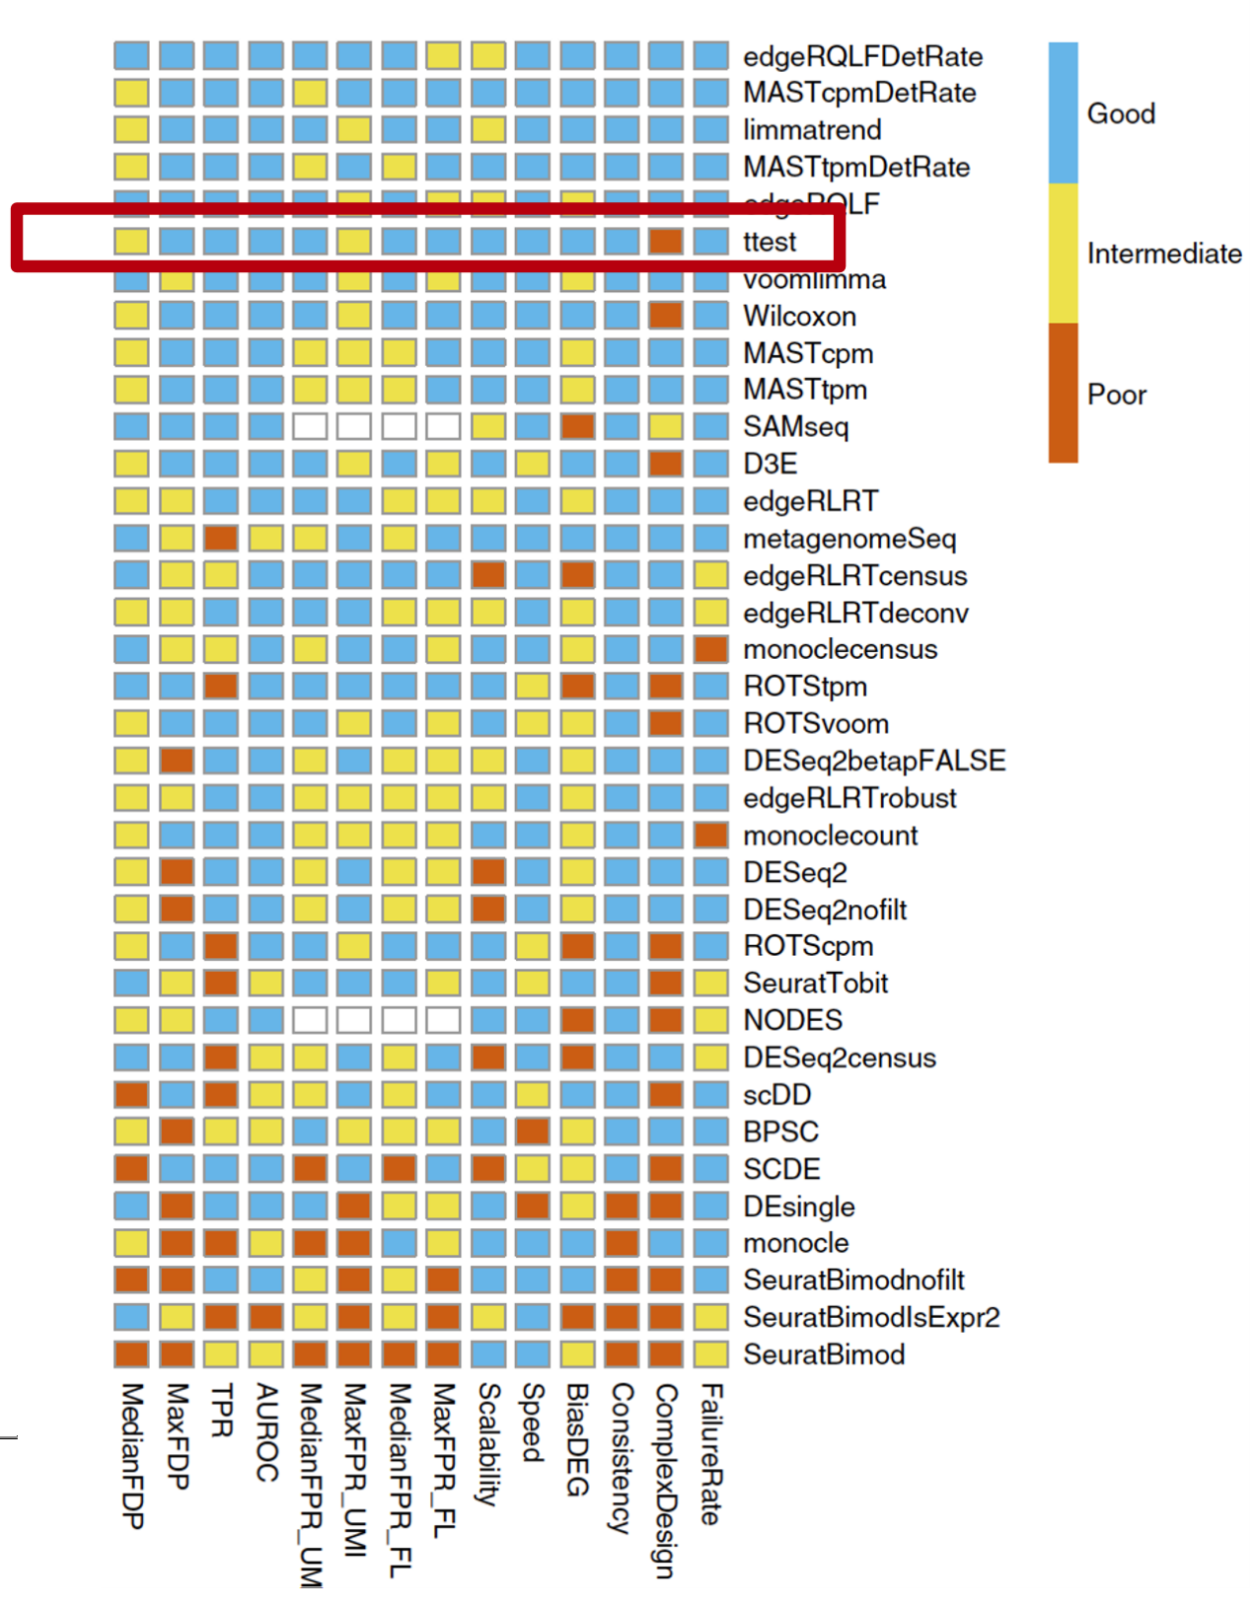
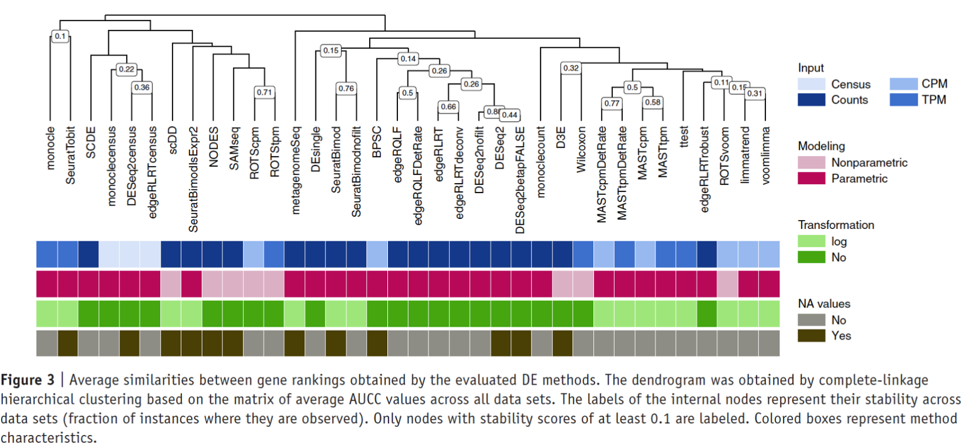
Differential Expression Testing: many different assays…
Again, different tests are available and depending on your study case, might be more/less appropriate.
I would recommend going with t-test as default.
Soneson and Robinson, 2018
56
Notes:
I would like to expand these observations to in vivo data. I also want to check what happens in terms of transcriptional dynamics in cells where Cyclin O, a key non-canonical cyclin involved in MCC diff., is knocked-out.

Slide 57
Analysis workflow
Pre-Processing
Clustering
Biology
Expression Matrix
(GENES x CELLS)
1. Identify
Variable Genes
5. Differentially Expressed Genes
Filter Cells /
Quality Control
2. Dimensionality Reduction
6. Assigning
Cell Type
Normalization
3. Clustering
7. Functional Annotation
4. Explore (known)
marker genes
Notes:
I would like to expand these observations to in vivo data. I also want to check what happens in terms of transcriptional dynamics in cells where Cyclin O, a key non-canonical cyclin involved in MCC diff., is knocked-out.

